Slide 1

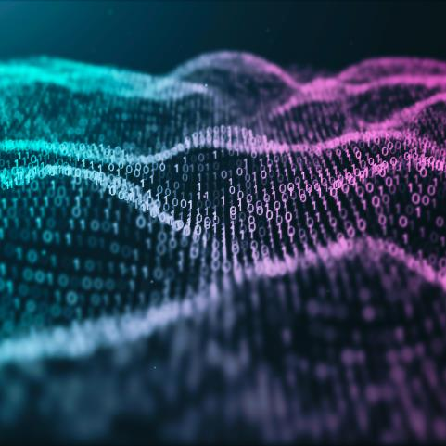
DIGITAL IMAGE PROCESSING
IMAGE TO TEXT CONVERSION

Slide 2


Agenda
INTRODUCTION
BACKGROUND
PROBLEM STATEMENT
PROPOSED METHODOLOGY
DATASETS
RESULTS AND ANALYSIS
CONCLUSION
REFERENCE

Slide 3




Introduction
In today's digital age, where images are ubiquitous, the ability to extract meaningful textual information from images has become increasingly important. The field of digital image processing offers powerful techniques to address this challenge by converting image data into a format that can be understood and utilized by computers. This project focuses on developing an Image to Text Conversion system using digital image processing methods, with the aim of extracting textual content from images accurately and efficiently

Slide 4

BACKGROUND:
The primary objective of this project is to design and implement a robust Image to Text Conversion system that can accurately extract text from a variety of image sources. The system will utilize digital image processing techniques to preprocess images, identify text regions, and apply OCR algorithms to recognize and extract textual content. The ultimate goal is to develop a reliable and efficient tool that can handle diverse image formats, languages, and text layouts.

Slide 5

PROBLEM STATEMENT :
In recent years, there has been an increasing demand for automatic conversion of textual information from images. This project aims to develop a system that can accurately extract text from images using digital image processing techniques and optical character recognition (OCR) technology.

Slide 6
PROPOSED METHODOLGY:
The design of the Image to Text Conversion system involve several key components and stages, each addressing specific aspects of the image processing pipeline. Here's an overview of the design and model:
1)Input Image Acquisition: The system begins by acquiring input images from various sources, including scanned documents, photographs, or digital snapshots. These images may be in different formats (e.g., JPEG, PNG) and resolutions.
2)Preprocessing: The acquired images undergo preprocessing to enhance their quality and improve text readability. Preprocessing techniques may include:
Image resizing: Adjusting the size of the image to a standard resolution.
Denoising: Removing noise and artifacts from the image.
Contrast enhancement: Improving the contrast between text and background.

Slide 7
3)Text Localization: Text localization techniques are applied to identify and isolate regions of interest containing textual content within the preprocessed images. This stage involves:
Edge detection: Detecting edges in the image using techniques such as Sobel or Canny edge detection.
Contour detection: Identifying candidate text regions based on contour analysis.
Region of interest (ROI) extraction: Extracting potential text regions from the image for further processing.
4)Optical Character Recognition (OCR): Once text regions are localized, OCR algorithms are employed to recognize and extract textual content from these regions. The OCR stage involves:
Feature extraction: Extracting features from the text regions, such as character shape and texture.
.

Slide 8

Character classification: Classifying individual characters using machine learning algorithms or pre-trained models.
Text reconstruction: Reconstructing recognized characters into words and sentences.
5)Post processing: The extracted text undergoes post processing to improve accuracy and readability. Post processing techniques may include:
Spell checking: Correcting spelling errors and inconsistencies in the recognized text.
Text formatting: Formatting the extracted text into paragraphs or structured format.
Language translation: Translating the extracted text into different languages if required.
6)Output Generation: Finally, the system generates output in the form of machine-readable text, which can be saved to a file or displayed to the user. Additionally, visual feedback, such as highlighting recognized text regions, may be provided for user verification.

Slide 9
DATASETS:
For each stage of the image processing pipeline, appropriate algorithms and models are selected based on their effectiveness, efficiency, and suitability for the task. Some commonly used algorithms and models include:
1)Image preprocessing: Techniques such as resizing, denoising, and contrast enhancement may utilize standard image processing functions provided by libraries like Open CV.
2)Text localization: Methods such as contour detection, connected component analysis, or deep learning-based object detection models (e.g., Faster R-CNN, SSD) may be employed for text localization.
3)OCR: OCR engines such as Tesseract, which is widely used and supports multiple languages, may be utilized for character recognition. Alternatively, custom OCR models based on deep learning frameworks like Tensor Flow or PyTorch can be trained using labeled text data.

Slide 10
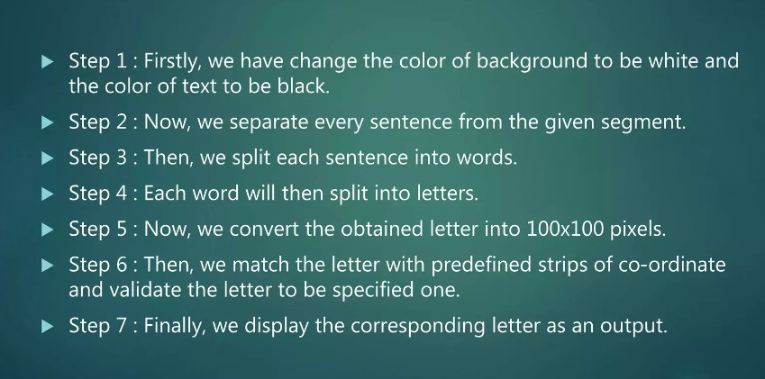
RESULTS AND ANALYSIS:
e

Slide 11
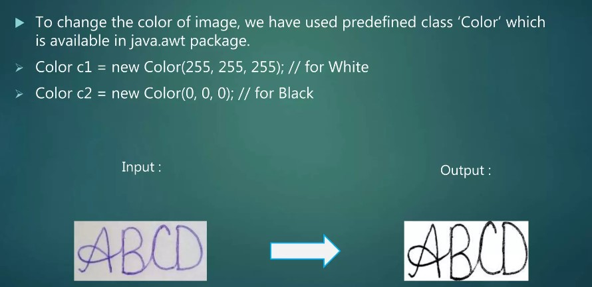

Slide 12
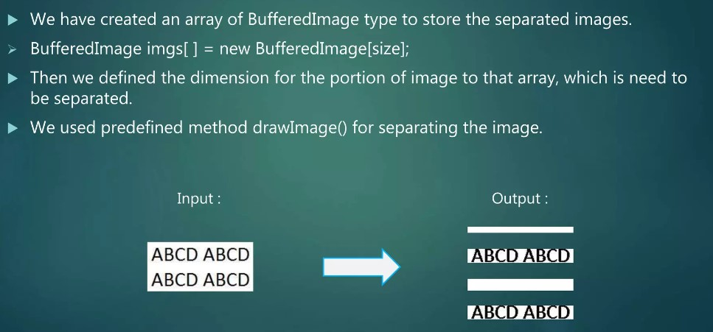

Slide 13
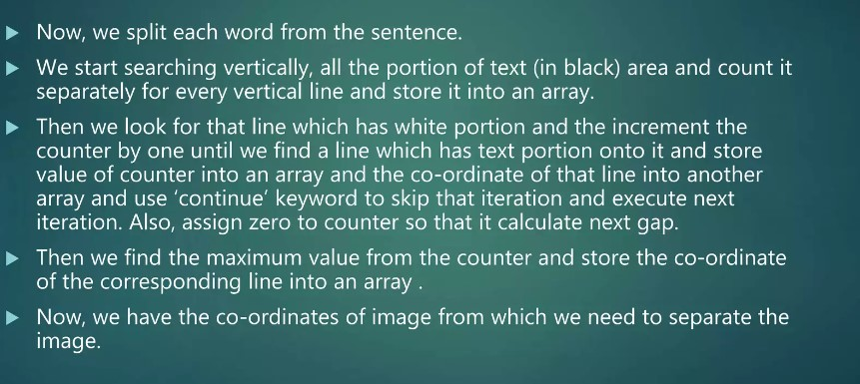
e

Slide 14
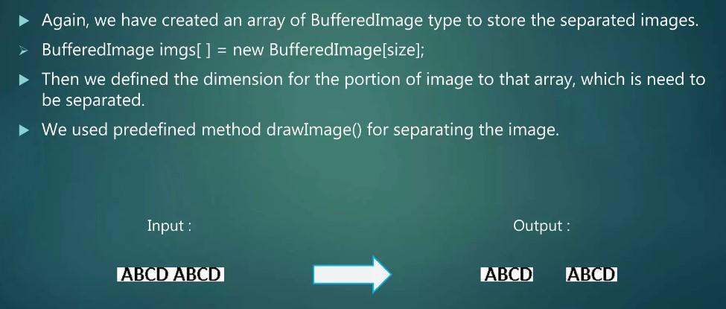

Slide 15
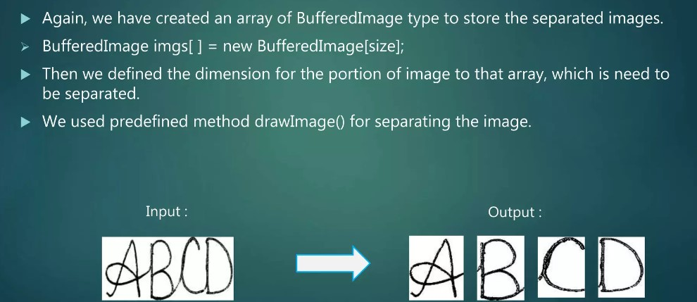

Slide 16
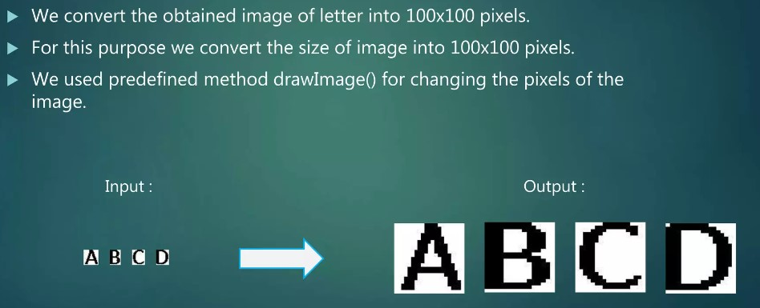

Slide 17
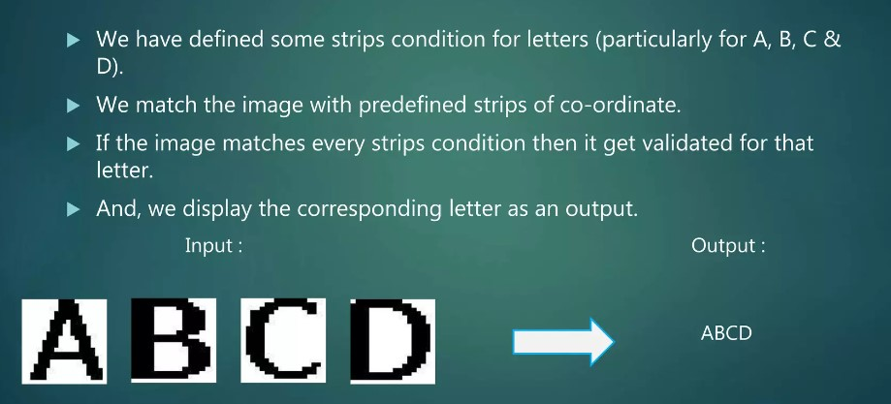

Slide 18

CONCLUSION
The Image to Text Conversion project, leveraging digital image processing techniques and Optical Character Recognition (OCR), has culminated in the development of a robust system capable of extracting textual information from images efficiently and accurately. Through a comprehensive workflow encompassing image preprocessing, text localization, OCR, and postprocessing stages, the system achieves the goal of converting image-based content into machine-readable text.

Slide 19
REFERENCE
https://www.geeksforgeeks.org/python-convert-image-to-text-and-then-to-speech/
https://www.hackersrealm.net/post/image-to-text-conversion-extraction-using-python

Slide 20

Thank You
DONE BY :
BRIJESH( RA2211026010443)
KOUSHIK VISHAL(RA2211026010384)
KISHORE KHANNAN H(RA2211026010409)

